Slide 1



Slide 2

This is the section title
Movies and TV Shows
ANALYSIS REPORT
SUBMITED BY,
Sibin Thomas
Techolas Technologies
2024-25

Slide 3

Introduction To
Amazon Prime Video has emerged as a major player in the world of streaming entertainment. Offering a vast collection of over 24,000 movies and TV shows, it has become a favorite among millions of viewers worldwide.
As of mid-2024, Prime Video's subscriber base has surpassed 200 million, cementing its place as one of the leading platforms in the streaming industry.

Slide 4
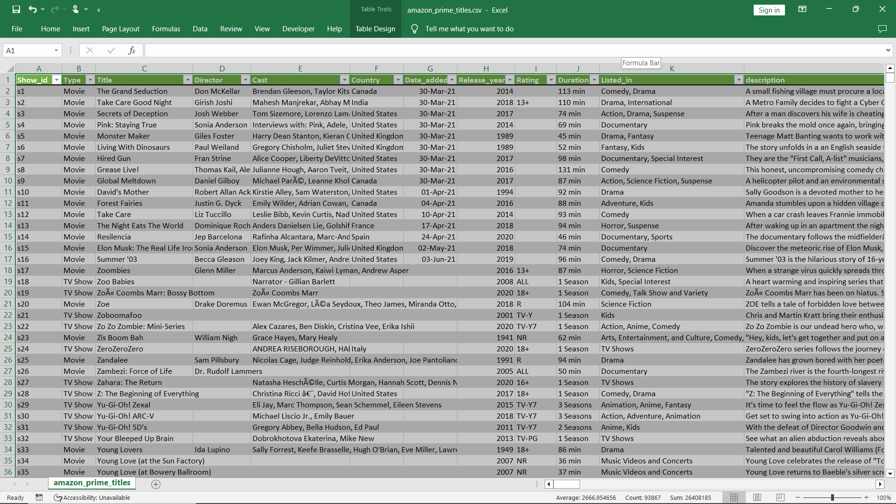

Desktop app
Dataset
You can replace the image on the screen with your own work. Just right-click on it and select “Replace image”

Slide 5
Key Details
TOTAL ENTRIES: The dataset contains 9669 entries, each representing a unique movie or TV show.
COLUMNS: There are 12 columns in the dataset:

Slide 6

Table of contents
SHOW ID : A unique identifier for each title
TYPE : The category of the title, which is either 'Movie' or ‘TV Show’.
TITLE : The name of the movie or TV show.
DIRECTOR : The director(s) of the movie or TV show.
CAST : The list of main actors/actresses in the title.
COUNTRY : The country or countries where the movie or TV show was produced.

Slide 7
Table of contents
7.DATE ADDED : The date the title was added to Prime Video.
8.RELEASE YEAR : The year the movie or TV show was originally released.
9.RATINGS : The age rating of the title.
10.DURATION : The duration of the title, in minutes for movies and seasons for TV shows.
11.LISTED IN : The genres the title falls under.
12.DESCRIPTION : A brief summary of the title.

Slide 8



Criterias Used
Shows Based on Age : Bar Chart
Total Shows by country : Map
Movies and Shows : Donut Chart
Genrers by total shows : Stacked area chart
Total Shows by release year : Area Chart
Total Titles,Total Genres,Total Directors,Total Types : Card

Slide 9
Dashboard
Using These Criterias

Slide 10
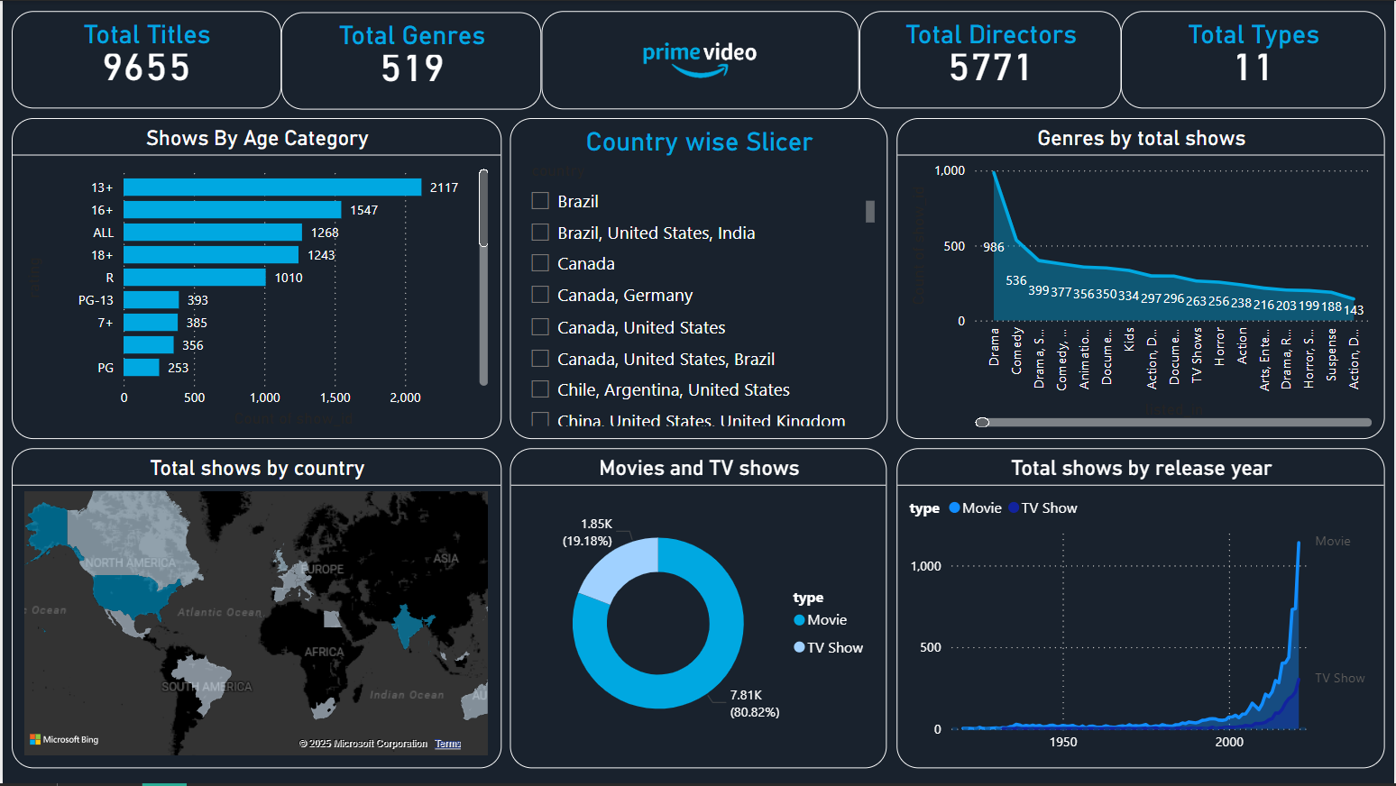
01
Section name
You can enter a subtitle here if you need it

Slide 11


Reference
Kaggle : https://www.kaggle.com/datasets/shivamb/amazon-prime-movies-and-tv-shows
Visualization : Power bi

Slide 12


